Slide 1
Age-Length Keys From Theory to Practice
2023 TESA best practices in ageing workshop
Lisa Ailloud, PhD
lisa.ailloud@noaa.gov
Southeast Fisheries Science Center
Miami, FL ◦ USA

Slide 2
Talk Outline
The importance of age composition
The “classic” forward Age-Length Key (ALK)
Assumptions, limitations and potential solutions
How big should my sample size be?
Case studies

Slide 3
The Importance of Age Composition
Age composition
Selectivity
M
F
Recruitment
Reproductive potential
Resilience
Management actions/rebuilding plans
Proportion of a fish population belonging to each age class
From catch curve analysis to integrated stock assessments
Errors ultimately affect evaluation of stock status & management

Slide 4
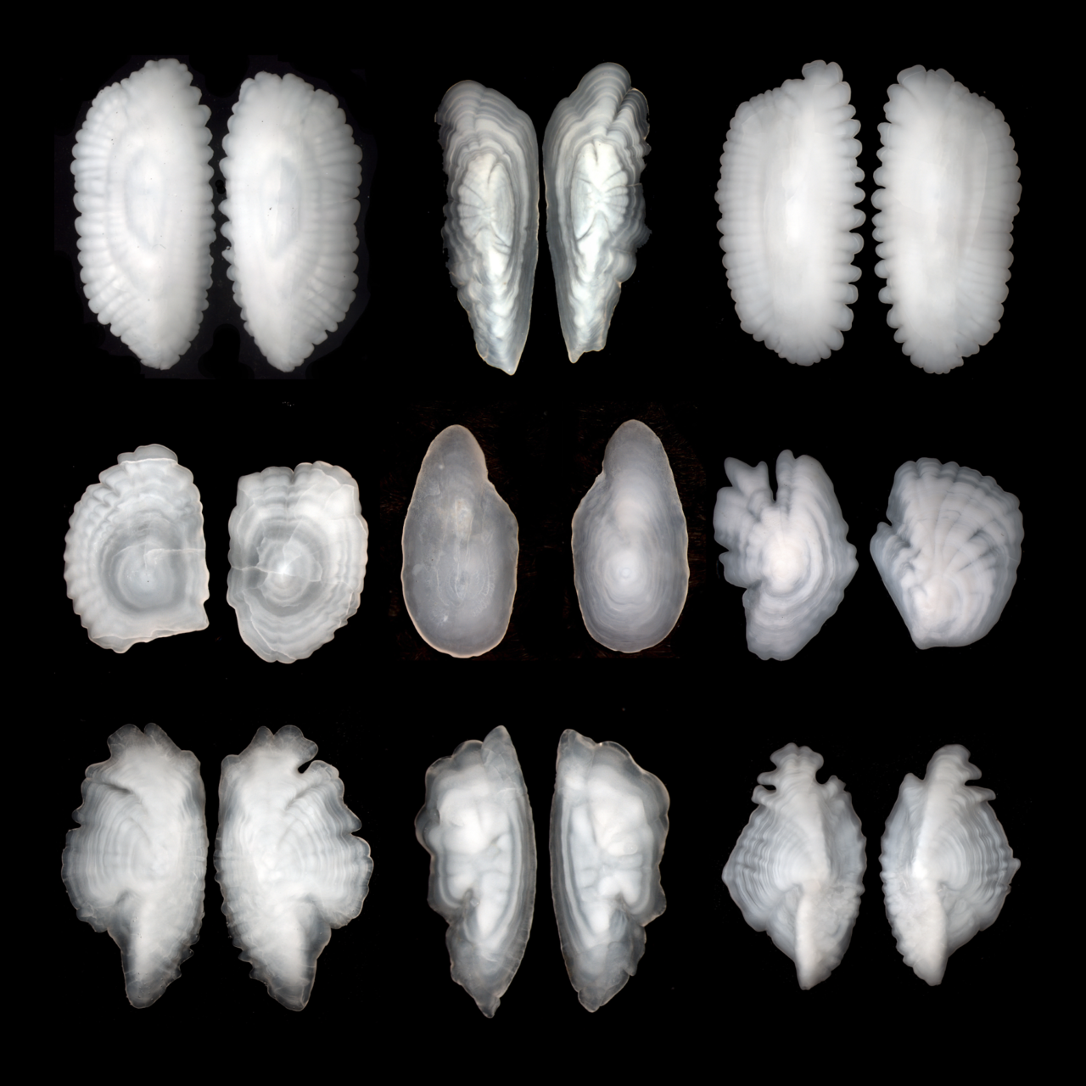
Why use ALKs?
The Importance of Age Composition
Ageing a random sample of the population
Costly and time consuming
Double sampling, aka. Age Length Keys
Fridriksson 1934, Tenenbein, 1972, Tanaka, 1953
1st stage: large random sample lengths (cheap!)
2nd stage: small age subsample (expensive!) through length-stratified sampling

Slide 5

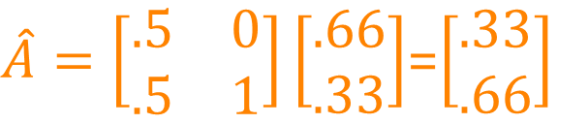
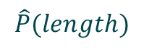
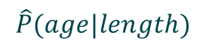
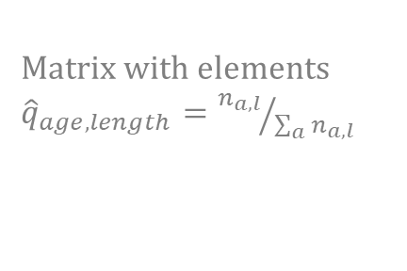
The “Classic” Forward Age-Length Key (ALK)
N=1000
N=500
?
Length sample
Matrix with elements
${\hat{q}}_{age,length}={n_{a,l}}/{\sum_{a}{n_{a,l}}}$
?
Sample sizes of fish belonging to each length bin
20cm
30cm
$$\hat{A}=Q\frac{Y}{N}$$
Total sample size of measured fish
N=80
N=20
Estimate of
age composition
N=10
Age 1
Age sample
N=10
Age 0
Age 1
20cm
30cm
$$\hat{P}(age|length)$$
$$\hat{P}(length)$$
N=1000
$\hat{A}=\left[\begin{matrix}.5 & 0 \\ .5 & 1\end{matrix}\right]\left[\begin{matrix}.66 \\ .33\end{matrix}\right]$=$\left[\begin{matrix}.33 \\ .66\end{matrix}\right]$
N=500
Age composition
Fridriksson, 1934
Age 0
Age 1
Ailloud and Hoenig 2019

Slide 6
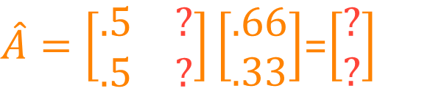
Assumptions, Limitations and Potential Solutions
N=1000
N=500
?
Length sample
Matrix with elements
${\hat{q}}_{age,length}={n_{a,l}}/{\sum_{a}{n_{a,l}}}$
?
Sample sizes of fish belonging to each length bin
20cm
30cm
$$\hat{A}=Q\frac{Y}{N}$$
DATA GAPS
N=0
Total sample size of measured fish
N=20
Estimate of
age composition
N=10
Age 1
?
Age sample
N=10
Age 0
20cm
30cm
$$\hat{P}(age|length)$$
$$\hat{P}(length)$$
?
$\hat{A}=\left[\begin{matrix}.5 & ? \\ .5 & ?\end{matrix}\right]\left[\begin{matrix}.66 \\ .33\end{matrix}\right]$=$\left[\begin{matrix}? \\ ?\end{matrix}\right]$
Age composition
Fridriksson, 1934
Ailloud and Hoenig 2019

Slide 7


Assumptions, Limitations and Potential Solutions
High
Recruitment
Low
Recruitment
P(age|length) influenced by spatio-temporal variations in vital rates
(recruitment, age-specific mortality rates, growth)
0
0
0
0
0
1
0
1
0
1
1
1
Borrow a key from one year to apply to another year
Develop an ALK from pooled years
Borrow a key from one area to apply to another if there are differences in age composition between areas
P(A=0|L)=5/6
P(A=0|L=20)=2/6
600 fish of length L
in your length sample
500 age 0
100 age 1
200 age 0
400 age 1

Slide 8




Assumptions, Limitations and Potential Solutions
Area 1
P(age|length) influenced by spatio-temporal variations in vital rates
(recruitment, age-specific mortality rates, growth)
1
1
1
0
0
1
1
1
Area 2
Borrow a key from one year to apply to another year
Develop an ALK from pooled years
Borrow a key from one area to apply to another if there are differences in age composition between areas
Area 2
0
0
0
0
0
1
0
0
1
1
Area 1
1
1

Slide 9
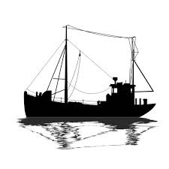


Assumptions, Limitations and Potential Solutions
P(age|length) influenced by spatio-temporal variations in vital rates
(recruitment, age-specific mortality rates, growth)
Borrow a key from one year to apply to another year
Develop an ALK from pooled years
Borrow a key from one area to apply to another if there are differences in age composition between areas
Borrow a key from one gear to apply to another gear as long as the gears are fishing on the same population
0
0
0
1
0
1
0
0
1
1
0
1

Slide 10
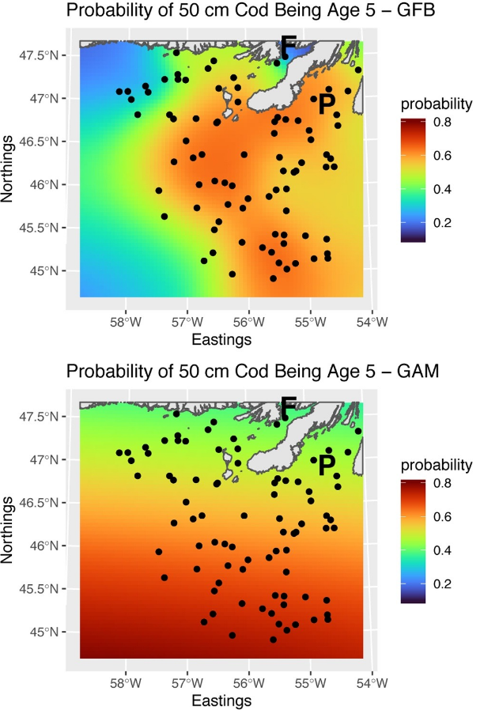
Assumptions, Limitations and Potential Solutions
Gaps in Data
Inverse ALK : P(length|age)
Clark, 1981; Bartoo and Parker, 1983; Hoenig and Heisey 1987;
Kimura and Chikuni, 1987 – see Ailloud & Hoenig 2019
Combined forward-inverse ALK
Hoenig et al., 2002 – see Ailloud & Hoenig 2019
Continuation Ratio Logits (CRLs) & GAMs
Stari et al 2010, Berg and Kristensen 2012
Spatial differences in vital rates
Sampling design (stratification?)
Model solutions
Berg and Kristensen 2012, Babyn et al. 2021
Unsure if you are violating assumptions?
Test for differences between ALKs
Gerritsen et al. 2006; Stari et al 2010, Berg and Kristensen 2012
Babyn et al. 2021

Slide 11
How big should my sample size be?
Subsampling scheme
Proportional subsampling
Fixed subsampling
Kimura (1977), Lai (1987), Tanaka (1953)
Goal?
Minimize total variance? Variance in the larger length categories? Costs?
Lai (1987), Tanaka (1953), Coggins et al. (2013)
Effective sample size
Chih (2010)
Optimize sampling scheme using a priori knowledge
Proportional
Fixed
e.g. every n^{th} fish caught
e.g. 10 size 10cm fish,
30 size 20cm fish, etc.
Ns do not need to be equal!

Slide 12
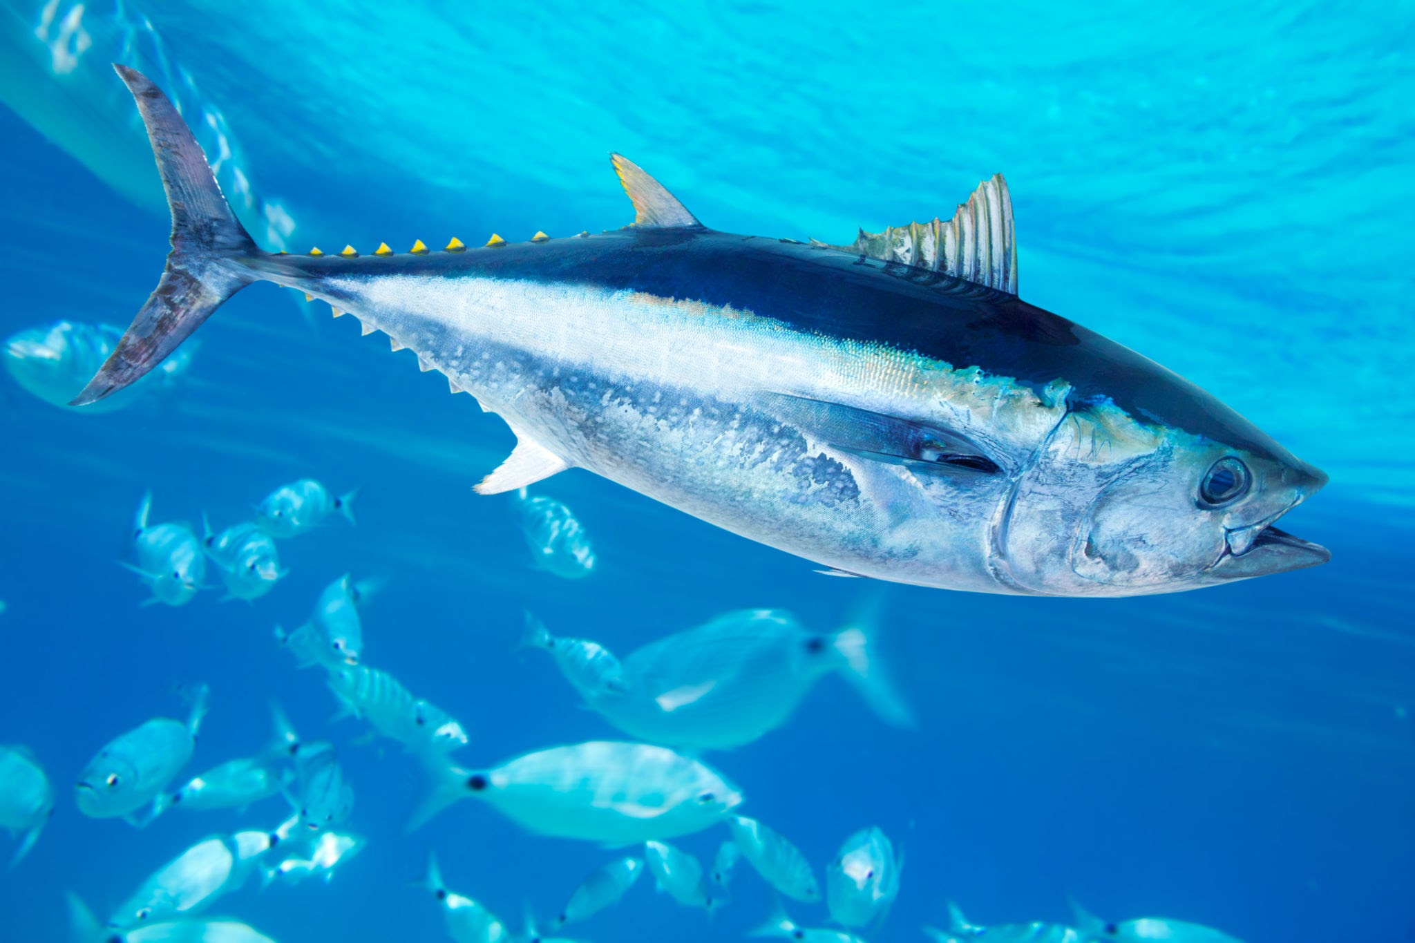
1. Atlantic Bluefin Tuna
Case Studies
Ailloud et al. 2019
Issue: sparse data, small n, collected opportunistically
Original approach: cohort slicing
Alternative solution: hybrid key, forward-inverse key
umaine.edu

Slide 13
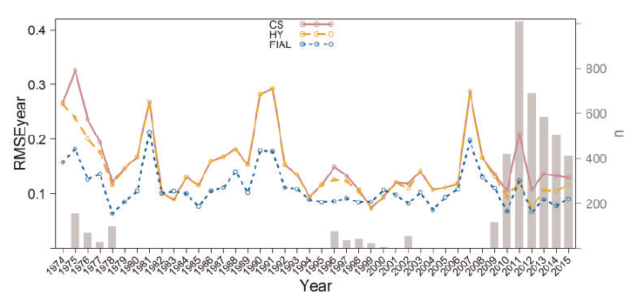

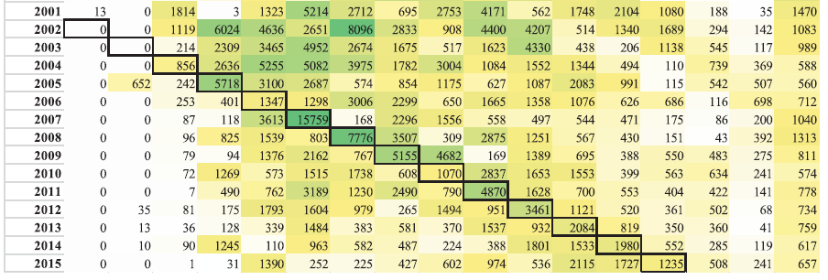
1. Atlantic Bluefin Tuna
Case Studies
Ailloud et al. 2019
Simulations
Forward-inverse key performed best
When applied to real data…
Better cohort tracking
Convergence issues
A few implausible results

Slide 14
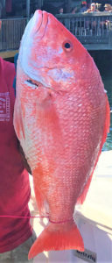
2. Gulf of Mexico Red Snapper
Case Studies
Ailloud 2022
Issue: gaps in data, regional differences in age composition
Original approach: pool years to create one ALK per region
Alternative solution: year & region specific smooth ALKs
Gulfcouncil.org

Slide 15
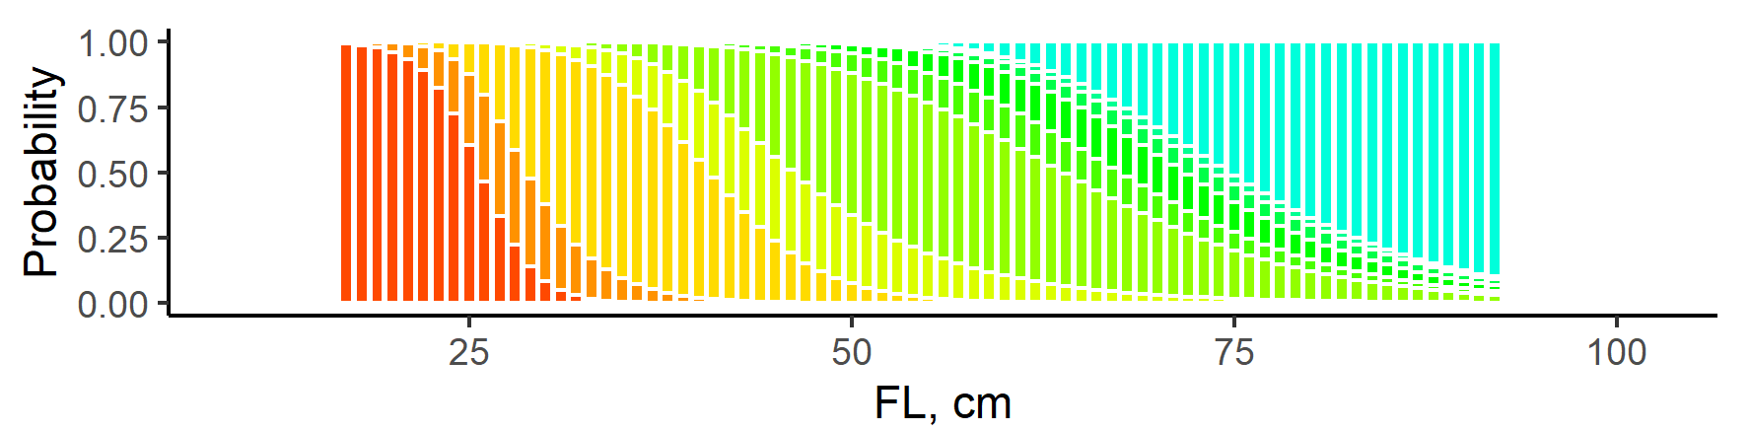
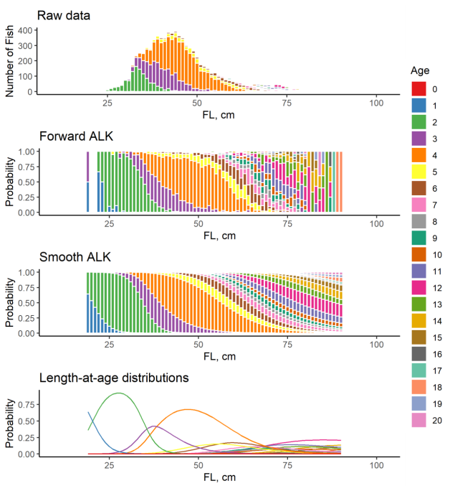
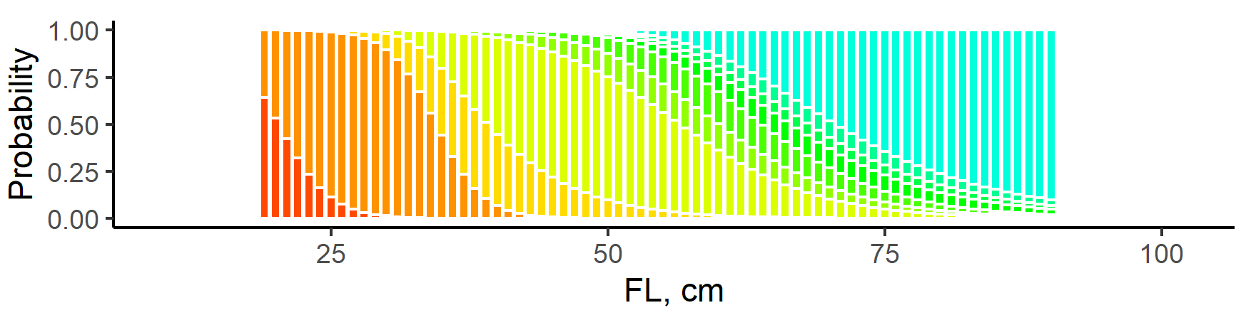
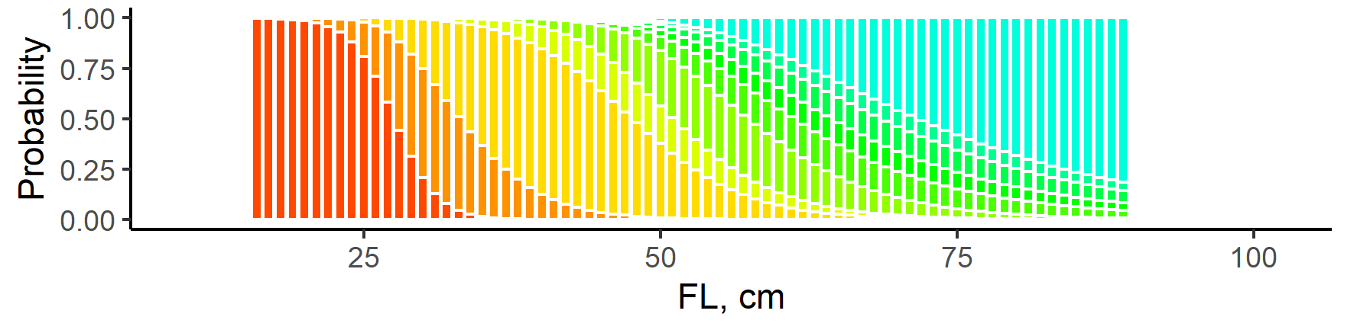
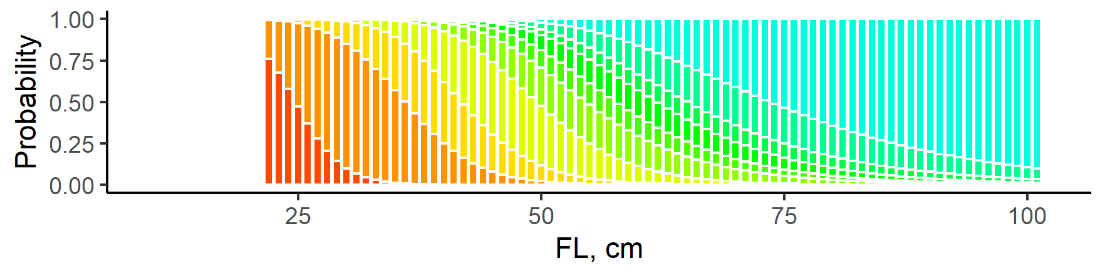
2. Gulf of Mexico Red Snapper
Case Studies
2019
Ailloud 2022
2018
2017
2016

Slide 16
Thank You! Questions?
Acknowledgements
John Hoenig (VIMS)
Matt Lauretta (NOAA Fisheries)
John Walter (NOAA Fisheries)
Data providers for the ICCAT Atlantic Bluefin tuna assessment and SEDAR GOM Red Snapper assessment

Slide 17
References
Aanes, S., and Vølstad, J. H. 2015. Efficient statistical estimators and sampling strategies for estimating the age composition of fish. Canadian Journal of Fisheries and Aquatic Sciences, 72: 938–953.
Ailloud, Lisa E. 2022. Gulf of Mexico Red Snapper (Lutjanus campechanus) Smooth Age Length Keys. SEDAR74-DW-20. SEDAR, North Charleston, SC. 67 pp. https://sedarweb.org/documents/sedar-74-dw-20-gulf-of-mexico-red-snapper-lutjanus-campechanus-smooth-age-length-keys/
Ailloud, L. E., Lauretta, M. V., Walter, III, J. F., and Hoenig, J. M. 2019. Estimating age composition for multiple years when there are gaps in the ageing data: the case of western Atlantic Bluefin tuna. ICES Journal of Marine Science, 10.1093/icesjms/fsz069.
Babyn, J., Varkey, D., Regular, P., Ings, D. and Flemming, J.M., 2021. A Gaussian field approach to generating spatial age length keys. Fisheries Research, 240, p.105956.
Chih, C. P. 2010. Incorporating effective sample sizes into sampling designs for reef fish. Fisheries Research, 105: 102–110.
Coggins, L. G., Gwinn, D. C., and Allen, M. S. 2013. Evaluation of age–length key sample sizes required to estimate fish total mortality and growth. Transactions of the American Fisheries Society, 142: 832–840.
Giancarlo M. Correa, Lorenzo Ciannelli, Lewis A.K. Barnett, Stan Kotwicki, and Claudio Fuentes. Improved estimation of age composition by accounting for spatiotemporal variability in somatic growth. Canadian Journal of Fisheries and Aquatic Sciences. 77(11): 1810-1821. https://doi.org/10.1139/cjfas-2020-0166
Fridriksson, A. 1934. On the calculation of age distribution within a stock of cod by means of relatively few age-determinations as a key to measurements on a large scale. Rapports et Proces-verbaux des Re´unions du Conseil International pour l’E´ xploration de la Mer, 86: 1–14.
Hoenig, J. M., Hanumara, R. C., and Heisey, D. M. 2002. Generalizing double and triple sampling for repeated surveys. Biometrical Journal, 44: 603–618.
Kimura, D. K. 1977. Statistical assessment of the age–length key. Journal of the Fisheries Research Board of Canada, 34: 317–324.
Kimura, D., and Chikuni, S. 1987. Mixtures of empirical distributions: an iterative application of the age-length key. Biometrics, 43: 23–35.
Lai, H. L. 1993. Optimal sampling design for using the age-length key to estimate age composition of a fish population. Fishery Bulletin, 91: 382–388.
Tanaka, S. 1953. Precision of age-composition of fish estimated by double sampling method using the length for stratification. Nippon Suisan Gakkaishi, 19: 657–670.
Tenenbein, A. 1972. A double sampling scheme for estimating from misclassified multinomial data with applications to sampling inspection. Technometrics, 14: 187–202.

